Slide 1
Nature Article Recommender
Vinny Thompson

Slide 2

Problem motivation
World’s leading multidisciplinary science journal
Amazing resource for those in scientific fields, but not so much for those without extensive STEM backgrounds
In todays climate, with misinformation and COVID both running rampant, it is more important than ever for laypeople to stay up to date on current events in the scientific world

Slide 3
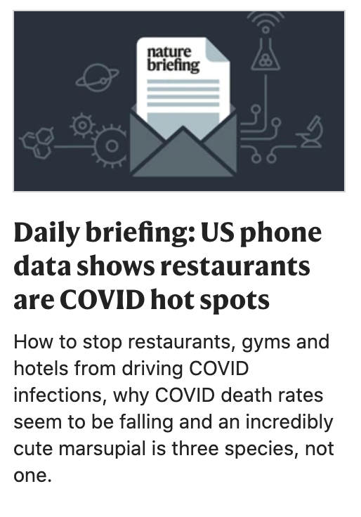
Goal
Complexity
Topic/subtopic
Date Published
Recommendation
Notes:
So my goal was to build a content-based recommender system that allows people to get up to date research relating to their topic of interest, with ideally as little complexity as possible.

Slide 4




Process
Topic Modeling
Physical Sciences
Environmental Sciences
Biological Sciences
Health Sciences
Notes:
-First was everyone’s part of the project, which was scraping from Nature’s website for news articles. I had over 40,000 articles, and went back as far as 1997, because further than that the article volume dropped off significantly, and my main goal providing a tool for current events. But I did go back to 1997, so that I could plot topic timelines and get some interesting insights about the progression of scientific discourse over time.
-I created my document-term matrix using a standard TF-IDF. And I did create a corpus-specific stop word list, as there were a lot of words that were just creating noise. Vaguely scientific words that don’t have anything to do with one topic, things like “research, lab, professor, journal, phenomenon”
-Then I went through some extensive topic modeling, which I’ll get into next, and finally I deployed an app for my recommender, along with some topic visualizations, using Dash

Slide 5
Results
Physical Sciences
Physics
Astronomy
Math/Computing
Space Exploration
Environmental Sciences
Biological Sciences
Health Sciences

Slide 6
Results
Physical Sciences
Physics
Astronomy
Math/Computing
Space Exploration
Climate Science
Geology/Ocean Science
Agriculture/Plant Science
Ecology/Biodiversity
Environmental Sciences
Biological Sciences
Health Sciences

Slide 7
Results
Physical Sciences
Physics
Astronomy
Math/Computing
Space Exploration
Climate Science
Geology/Ocean Science
Agriculture/Plant Science
Ecology/Biodiversity
Environmental Sciences
Neuroscience
Genetics/Genomics
Stem Cells
Cell/Molecular Biology
Biological Sciences
Health Sciences

Slide 8
Results
Physical Sciences
Physics
Astronomy
Math/Computing
Space Exploration
Climate Science
Geology/Ocean Science
Agriculture/Plant Science
Ecology/Biodiversity
Environmental Sciences
Neuroscience
Genetics/Genomics
Stem Cells
Cell/Molecular Biology
Biological Sciences
Health Sciences/Other
Diseases/Epidemics
Drug Discovery
Government/Policy
International Affairs

Slide 9
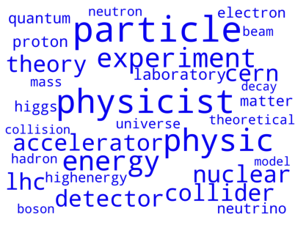
Results
Physical Sciences
Physics
Astronomy
Math/Computing
Space Exploration
Climate Science
Geology/Ocean Science
Agriculture/Plant Science
Ecology/Biodiversity
Environmental Sciences
Neuroscience
Genetics/Genomics
Stem Cells
Cell/Molecular Biology
Biological Sciences
Health Sciences/Other
Diseases/Epidemics
Drug Discovery
Government/Policy
International Affairs

Slide 10
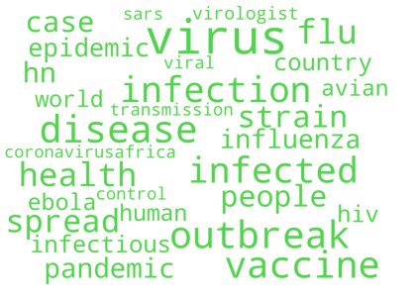
Results
Physical Sciences
Physics
Astronomy
Math/Computing
Space Exploration
Climate Science
Geology/Ocean Science
Agriculture/Plant Science
Ecology/Biodiversity
Environmental Sciences
Neuroscience
Genetics/Genomics
Stem Cells
Cell/Molecular Biology
Biological Sciences
Health Sciences/Other
Diseases/Epidemics
Drug Discovery
Government/Policy
International Affairs

Slide 11
Results
Physical Sciences
Physics
Astronomy
Math/Computing
Space Exploration
Climate Science
Geology/Ocean Science
Agriculture/Plant Science
Ecology/Biodiversity
Environmental Sciences
Neuroscience
Genetics/Genomics
Stem Cells
Cell/Molecular Biology
Biological Sciences
Health Sciences/Other
Diseases/Epidemics
Drug Discovery
Government/Policy
International Affairs
Not done yet…
Notes:
-Now obviously these categories are still fairly broad as far as scientific disciplines go, and I was interested in seeing how narrow I could go

Slide 12
Results
Climate Science
Pollution/Air Quality
Renewable Energy
Deforestation
International Cooperation
Phytoplankton
Extreme Weather Events
131 Subtopics
20+ articles belonging to each subtopic
Notes:
-So I split up my corpus into subsets based on each of these topics, modified my stop word list slightly for each, and ran them again through NMF, which left me with 131 subtopics

Slide 13
Results
Diseases, Epidemics
COVID-19
Ebola
HIV
Mosquito-borne (Zika, yellow fever, etc)
Malaria
Bird Flu/Swine Flu (H1N1)
Neuro-degenerative Diseases
Polio
Neuroscience
Linguistics/Speech Pathology
Visual System
Motor Control, Neural Circuits
Auditory System
Emotion, Emotional Disorders
Depression, Anxiety, PTSD
Olfactory System
Sleep, Memory
Notes:
-So I split up my corpus into subsets based on each of these topics, modified my stop word list slightly for each, and ran them again through NMF, which left me with 131 subtopics

Slide 14
Demo

Slide 15
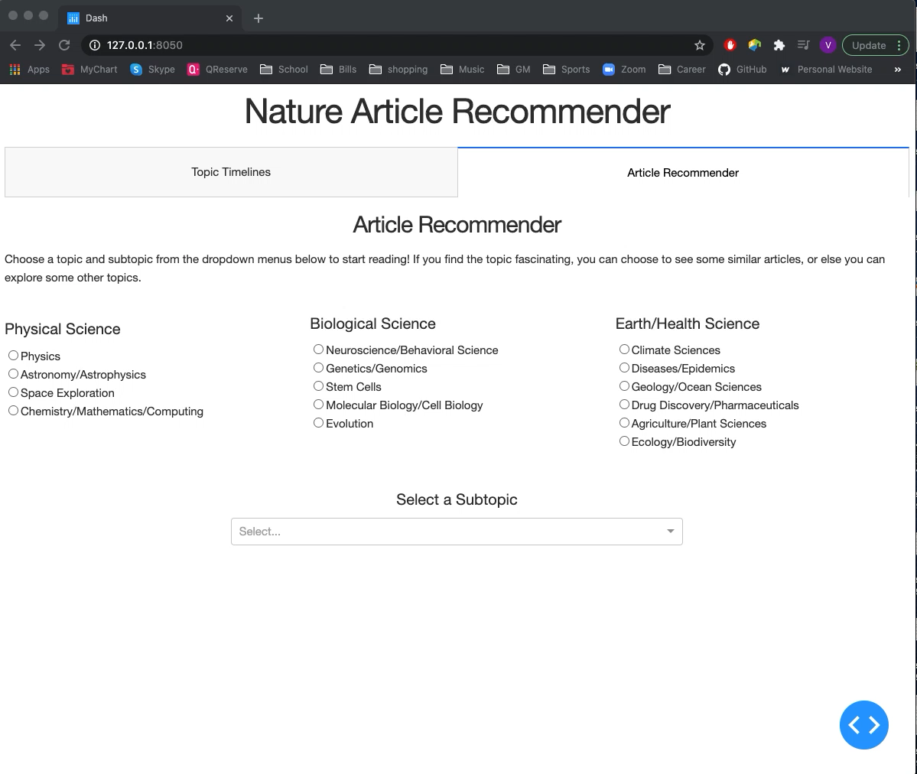

Slide 17
Appendix

